Slide 1
MyMediaJam
National Institute of Technology,
Uttarakhand
Final Presentation
Presented By :
Chinmay Jain (BT12CSe001)
Abhinav Kumar (BT12CSE009)

Slide 2
CONTENTS
Introduction
Advantages
Design Approach
Crawler Module
Index Manager
View Module
Tools and Technology
Scope
Future Scope
Snapshots
Refrences

Slide 3
Introduction
MyMediaJam is a true web based solution with multi-layered architecture and centralized database.
Provides faster local searching than the default Operating System.
Hierarchical RB tree and Hashed tree approach is used for reducing the search time complexity.
Highly parameterized to support constantly changing media in the local machine.

Slide 4
Advantages
Comparison of Existing and Proposed System
Properties | Existing System | Proposed System
Searching Complexity | Slow | Fast
Advanced Search | Slow | Fast
Number of Results (Filtered) | Low | High
Filtering | Slow | Fast
Reliability | Poor | Excellent
Graphics User Interface | Not Attractive | Attractive

Slide 5
Design Approach
MyMediaJam uses the modular approach. The complete project can be divided into 3 main modules:
Crawler Module
Index Manager
View Module

Slide 6
Crawler Module
This module uses the Breadth-First Search design approach for fast crawling.
The Crawling Module is divided into 3 sub-modules:
Music Module
Videos Module
Images Module
These modules works differently for different types of files, filtering out the undesired results, and proving the selected results to the View Manager.

Slide 7
Index Manager
This is the main module that manages insertion, deletion & updating the entries into tree.
Also responsible for searching over the tree, its serialization as well as deserialization.
Creates separate indexes for different file types.

Slide 8
Contd.
The indexing in done on a hierarchy of trees. The trees are divided on 4 levels:
Root Tree: This is the root tree that contains a mapping of alphabets with the sub-root tree. Each node in a tree is a sub-root tree that contains a mapping with an alphabet. There can be at maximum of 27 such nodes, one for each alphabet and 1 for special characters.
Sub-Root Tree: This is the 2nd level tree that contains a mapping of alphabets with the hash tree. Every sub-root tree is a node in the root tree. Each node in sub-root tree is a hash tree that contains a mapping with an alphabet. There can be at maximum of 27 such nodes, one for each alphabet and 1 for special characters.

Slide 9
Contd.
Hash Tree: This is the 3rd level tree that contains a mapping of alphabets with the RB tree (last level). Every hash tree is a node in the sub-root tree. Each node in hash tree is a RB tree that contains a mapping with an alphabet. There can be at maximum of 27 such nodes, one for each alphabet and 1 for special characters.
RB Tree: This is the last level of the tree structure. It contains the list of the files after being mapped from the parent trees. These files are stored in the RB tree structure.
Node: A node represent a single entity in a RB tree. It contains information about the file, its left child, its right child, its parent and its colour.

Slide 10
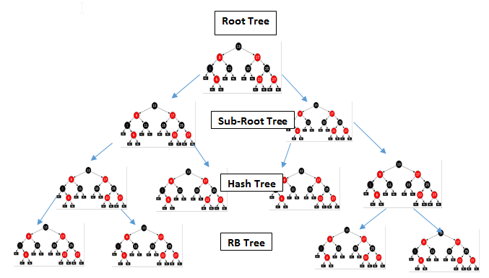
The Tree Structure
Figure. The MyMediaJam Tree Structure

Slide 11
Working
File ‘apple.mp3’
Root Tree
Sub-Root ‘a’
Sub-Root ‘a’
Hash Tree ‘p’
Sub-Root ‘a’
Hash Tree ‘p’
RB Tree ‘p’
Node
File ‘apple.mp3’
Left child
Right child
Parent
Colour
Figure. Working of the Index Manager

Slide 12
View Module
This module handles all the user interface design features provided to the users.
The view module is designed in such a way that it provides flawless design to ensure good user experience.
It can be further divided into multiple modules:
Register Module
Login Module
Directory Module
Search Module
Tutorial

Slide 13
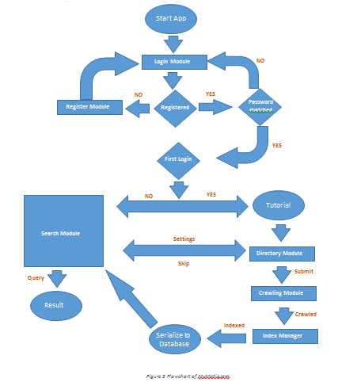
Figure. Flowchart of MyMediaJam

Slide 14
Tools and Technology
Technology: JSP,Servlet, Struts
Programming language: Java,JavaScript,Jquery,HTML,CSS,Ajax
Software Development Kit: JDK 1.7.0
Tools: NetBeans IDE 7.3.1,Apache Tomcat Server,MySQL Workbench,MySQL Database.

Slide 15
Scope
This project has a large scope as it has the following features which helps in making it easy to use, understand and modify it:
Fast searching of music, videos, images, and documents.
Smooth and user friendly GUI.
Ability to manage directories and updating index.
To save the time of searching a document or file manually.
Integrated media player, image and document viewer. (Optional)
This software package can be readily used by non-programming personal avoiding human handled chance of error. The target audience includes all those peoples who wants to manage their data efficiently.

Slide 16
Future Scope
The next version can handle more file formats such as .pdf, .word, .txt, .exe, .rar, .sql, .java, .cpp, .htm, .cfg, .xml, etc to be accepted by this application.
The extended version will run directly from the online server and more number of users can use this application at a time and more efficiently by maintaining a permanent database.
The next version of this application will include a single player which will handle all type formats.
In near future the application can be advanced to be used by more no. of platforms such as android, windows, ios, etc.

Slide 17
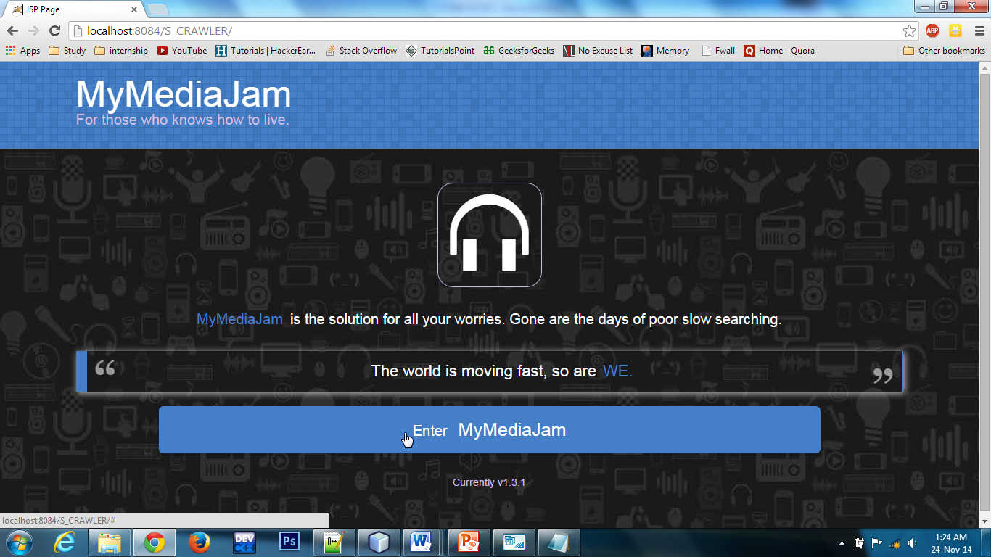
Snapshots
Home

Slide 18
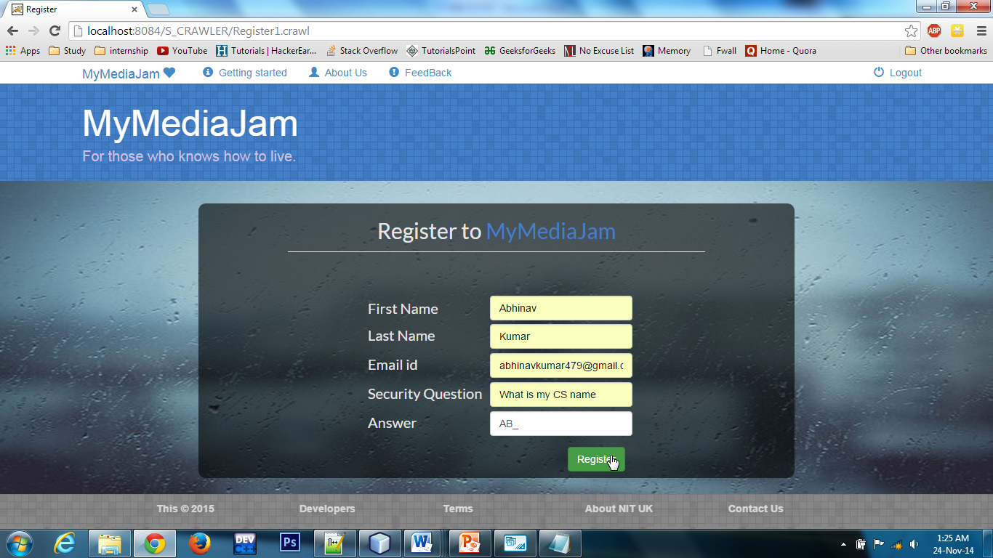
Contd.
Registration Page

Slide 19
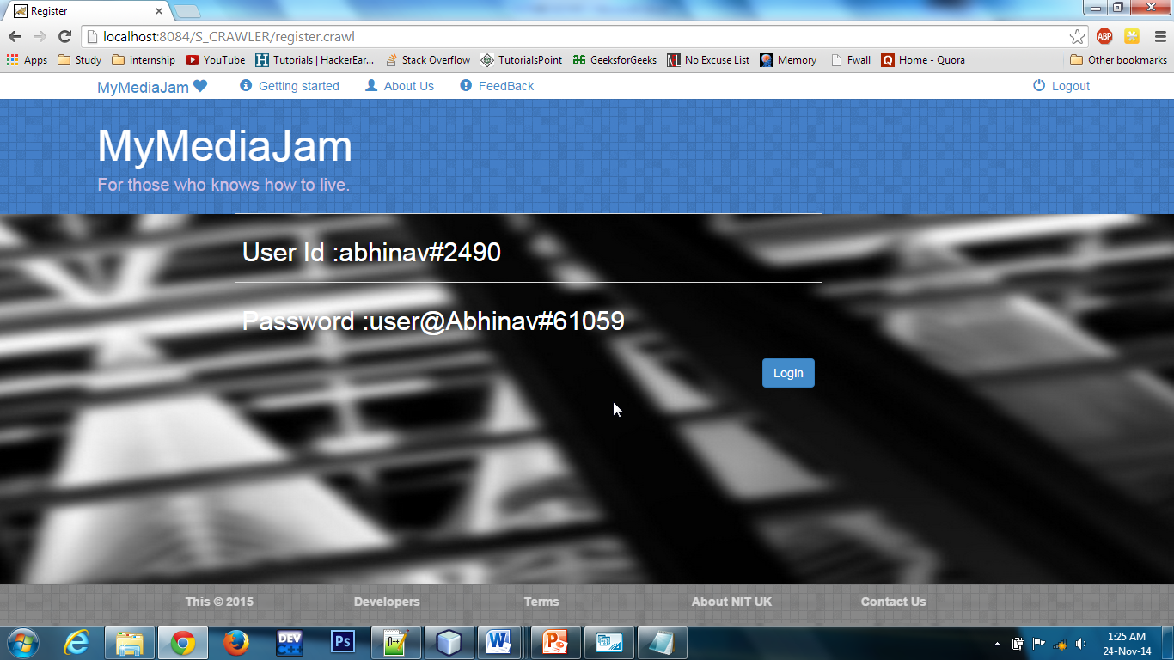
Contd.
Register Successful

Slide 20
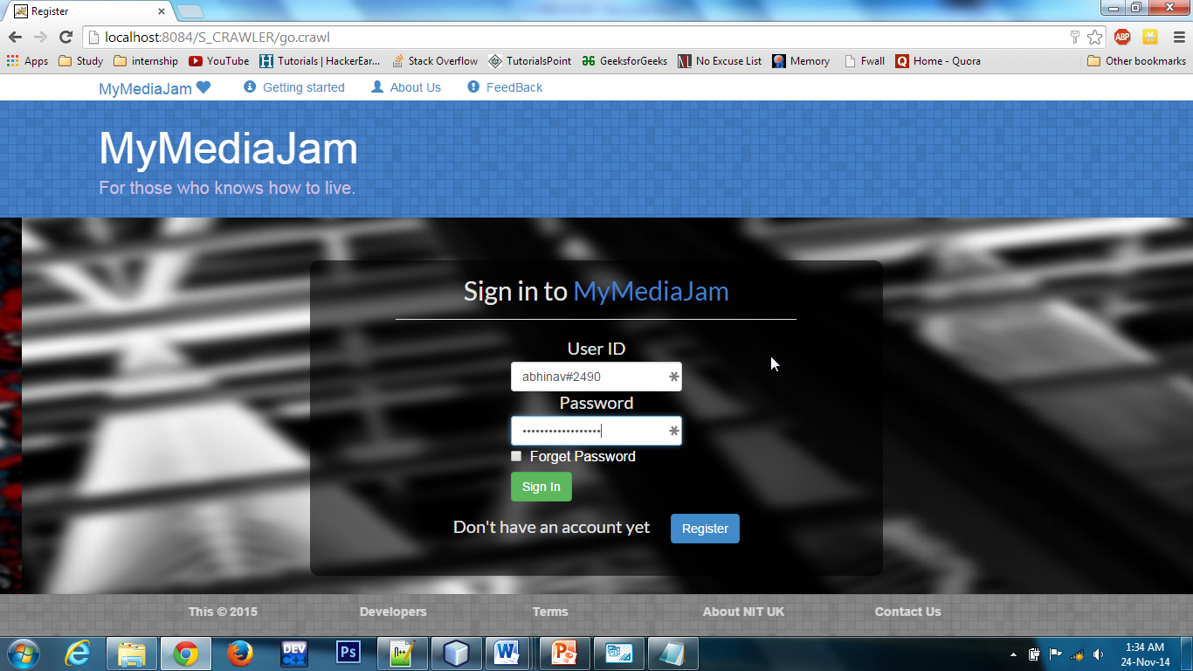
Contd.
Login Page

Slide 21
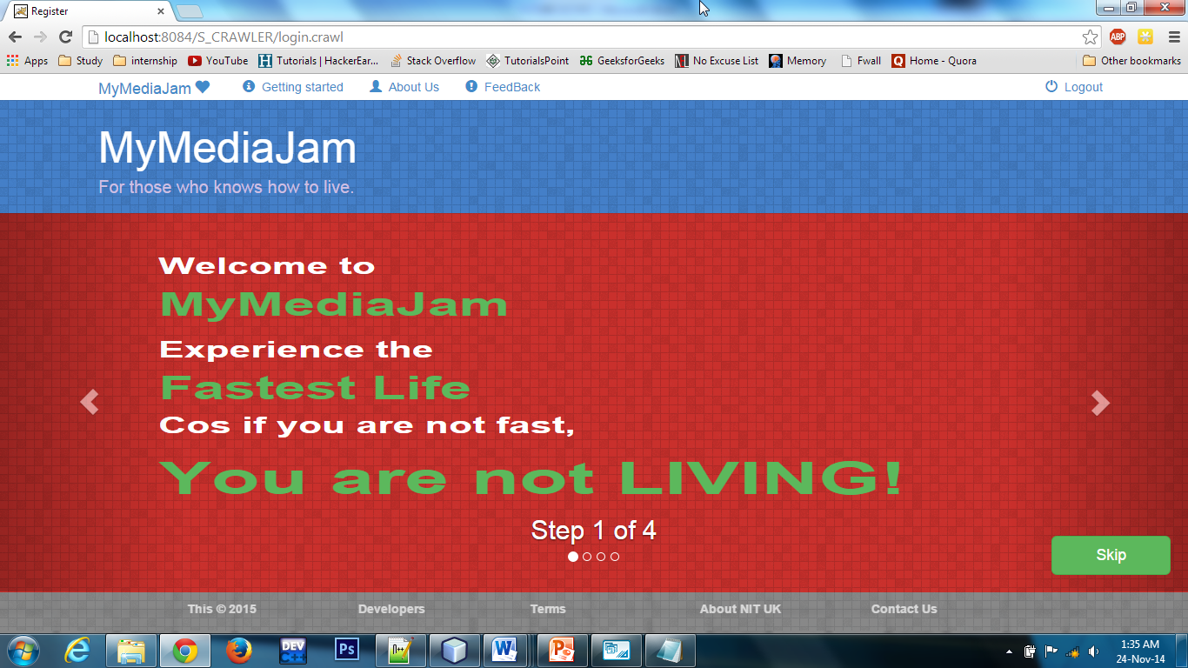
Contd.
Tutorial 1

Slide 22
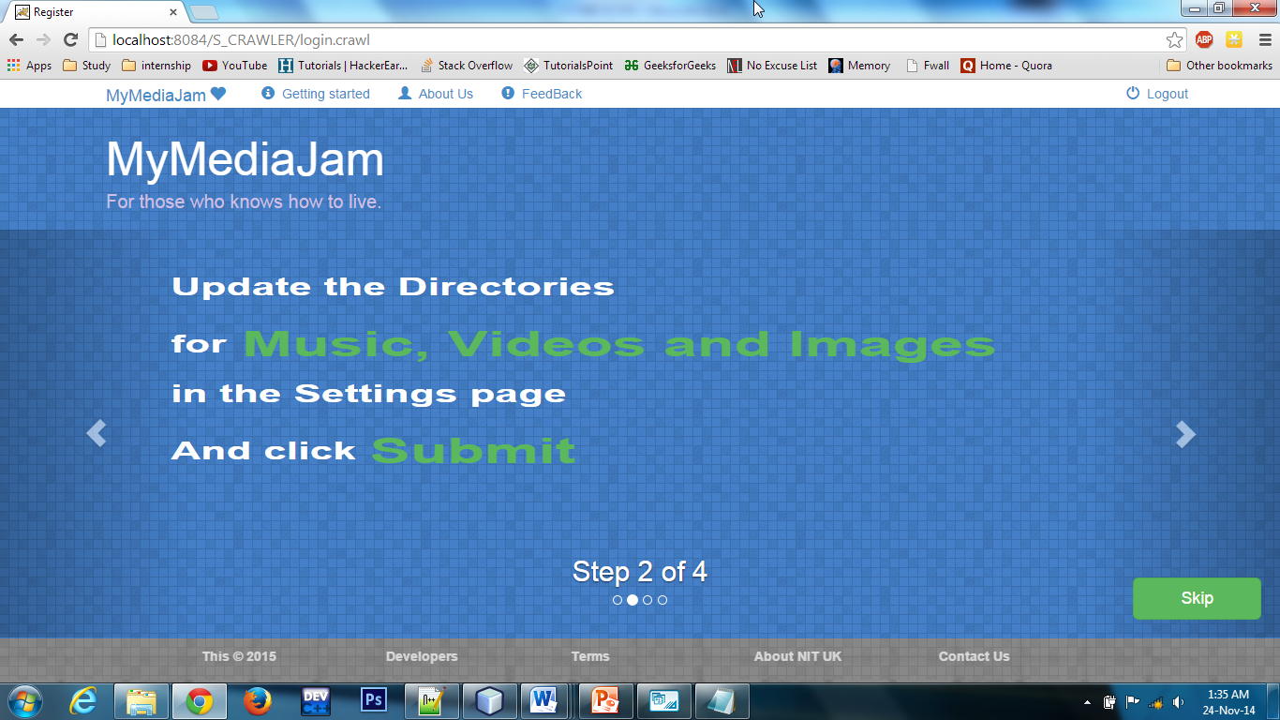
Contd.
Tutorial 2

Slide 23
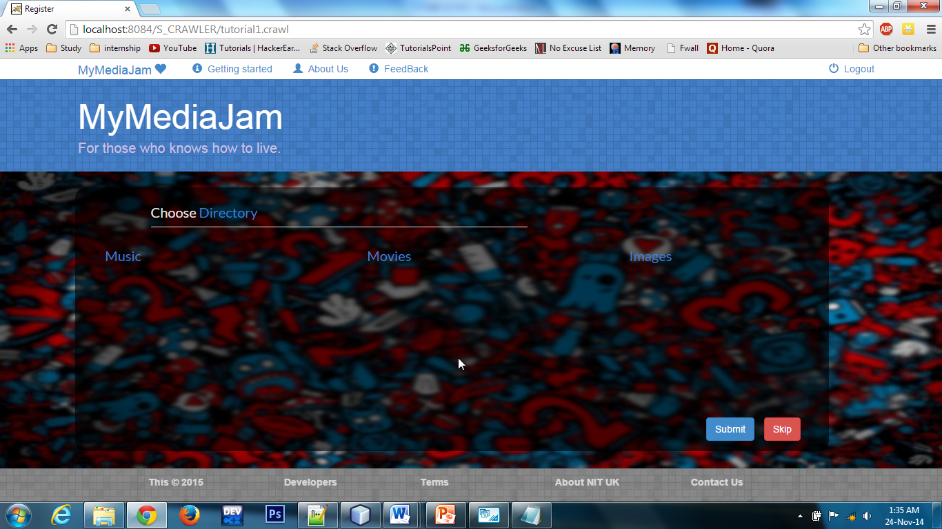
Contd.
Directory Chooser

Slide 24
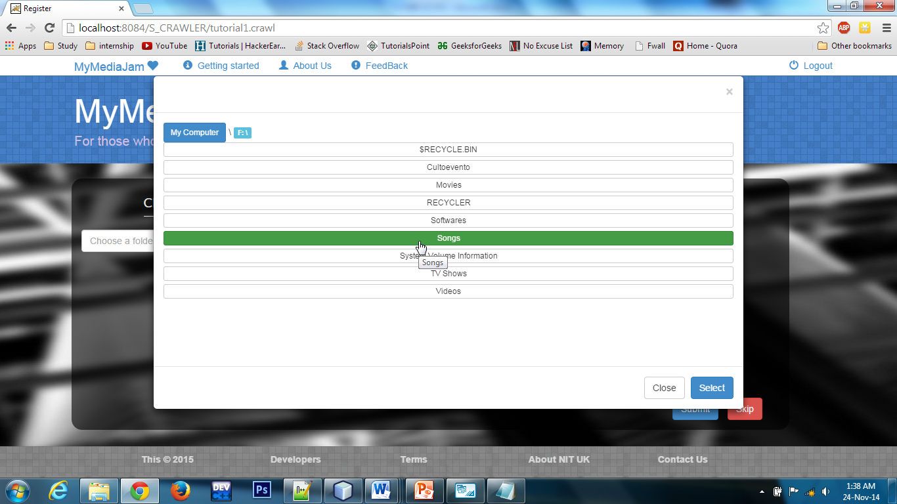
Contd.
File Modal Dialogue

Slide 25
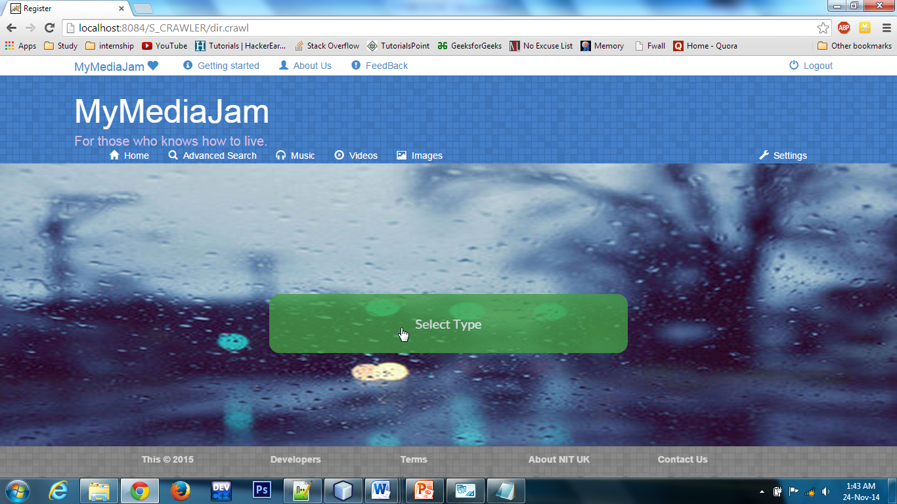
Contd.
Select Type

Slide 26
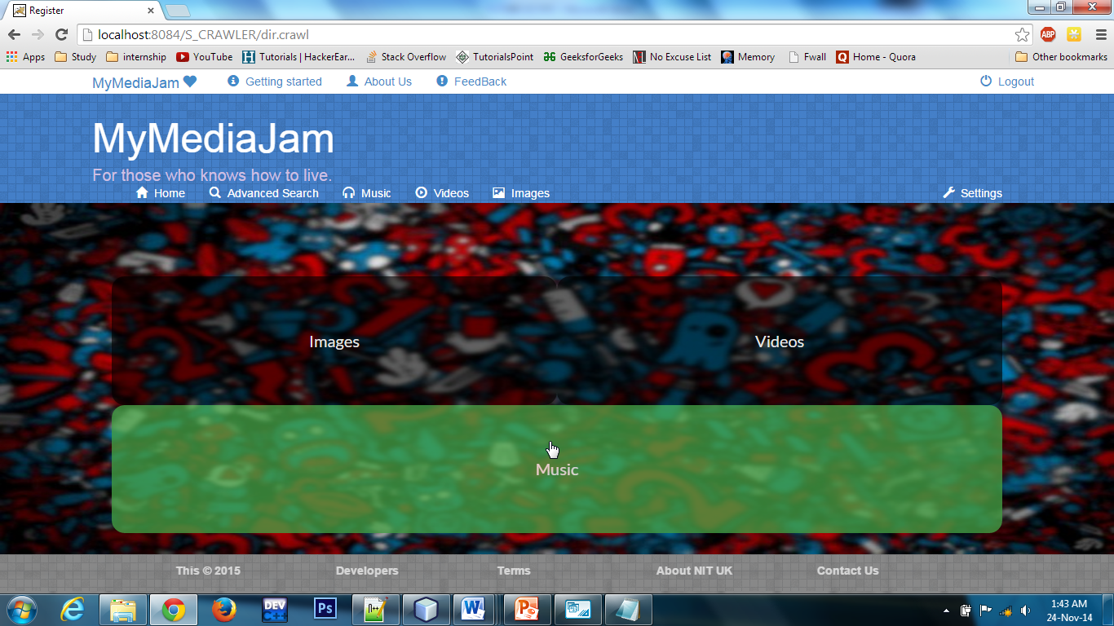
Contd.
Type - Music

Slide 27
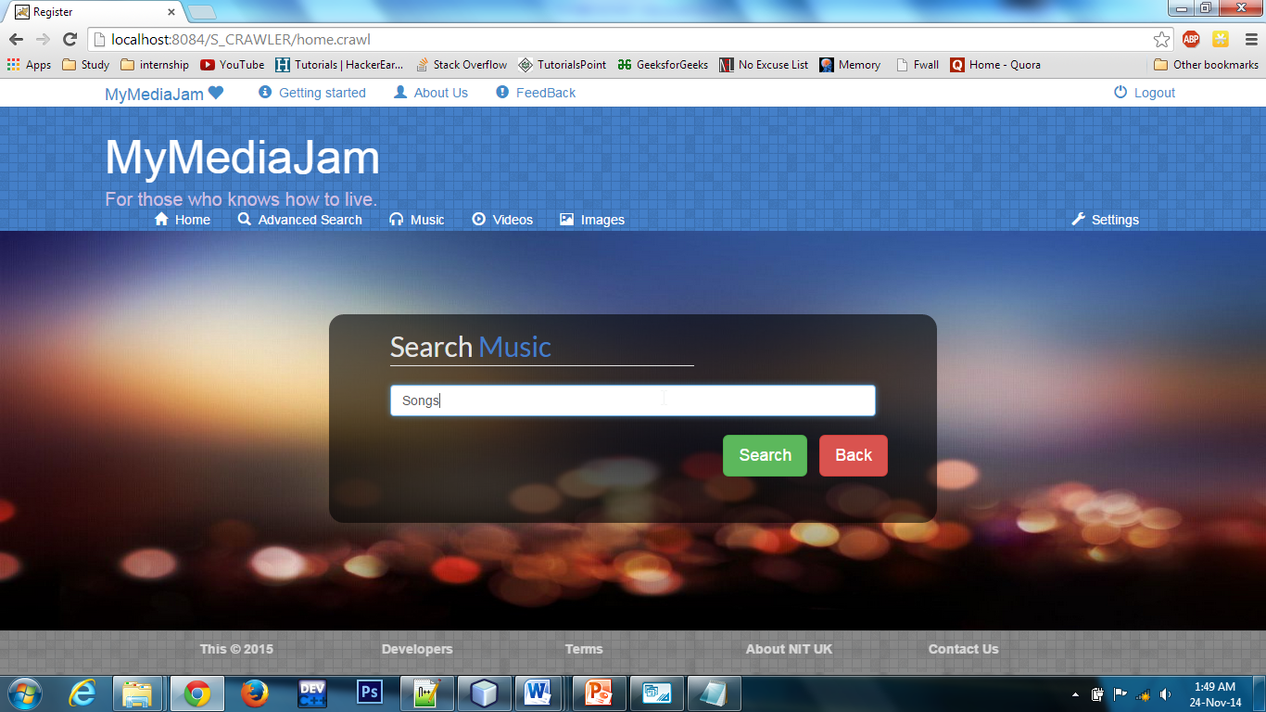
Contd.
Insert Query
DSC

Slide 28
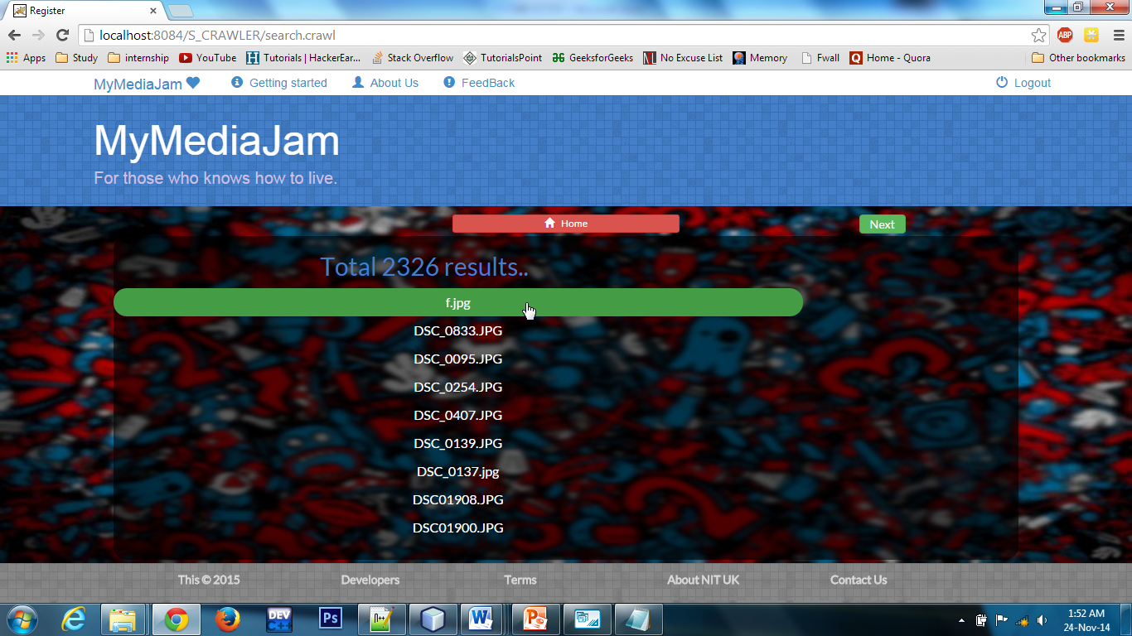
Contd.
Results Page

Slide 29
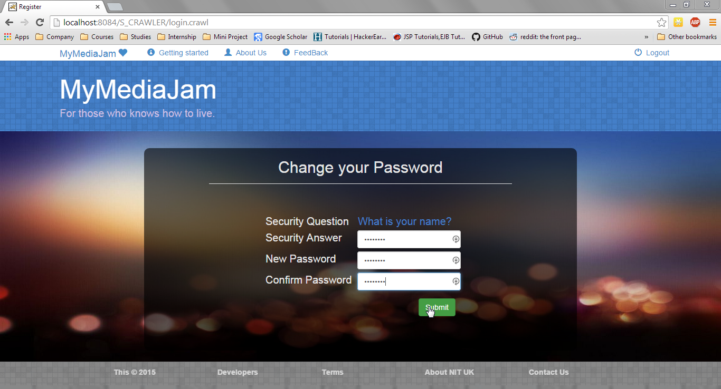
Contd.
Forget Password Page

Slide 30
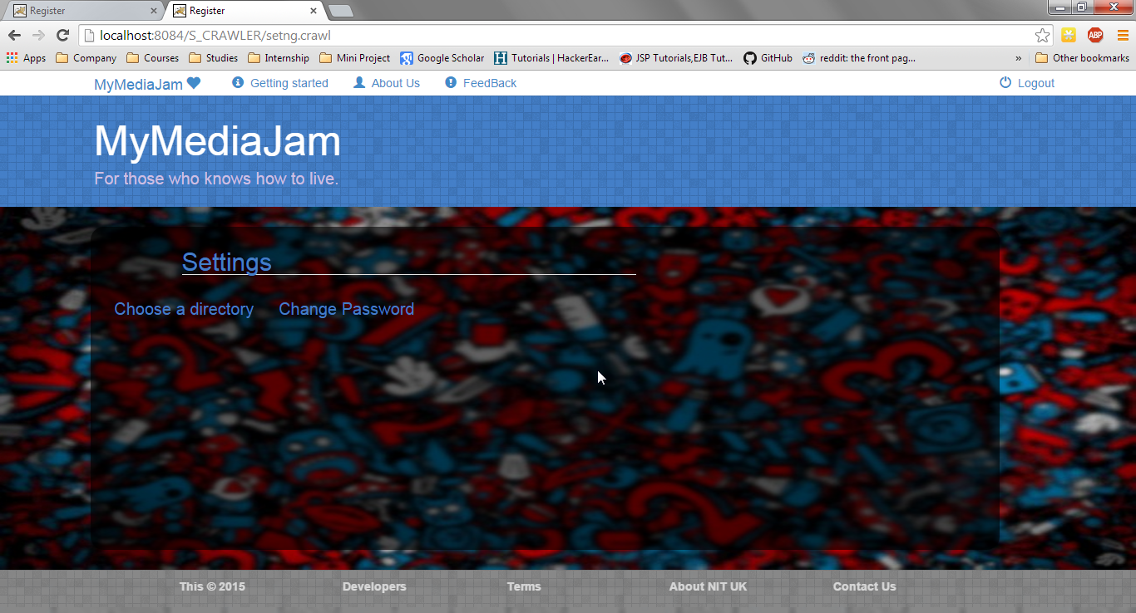
Contd.
Settings Page

Slide 31
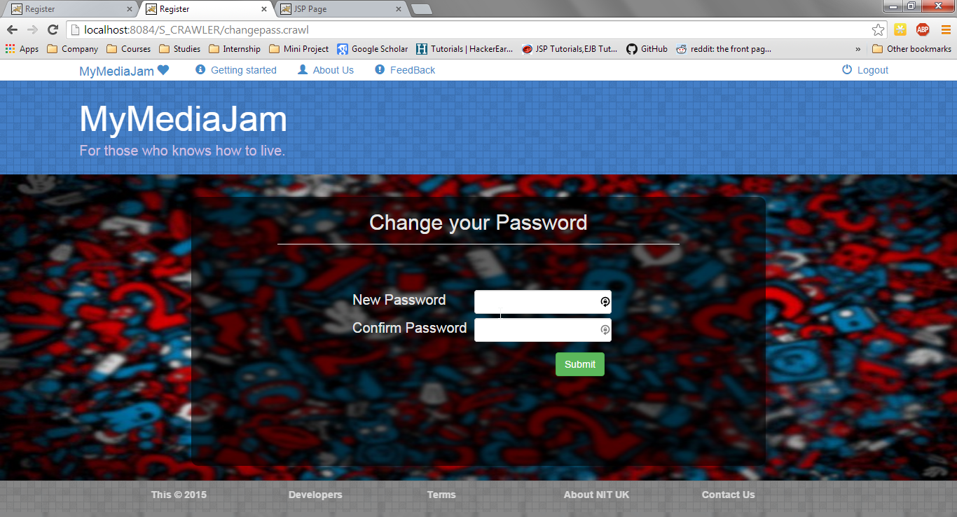
Contd.
Change Password Page

Slide 32
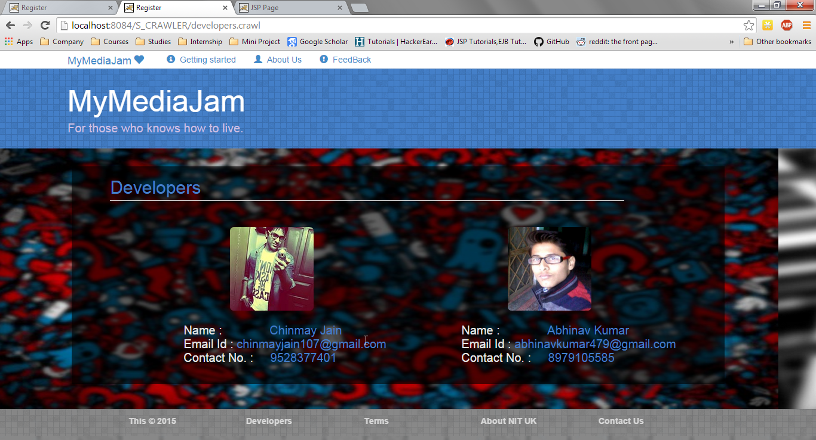
Contd.
Developers Page

Slide 33
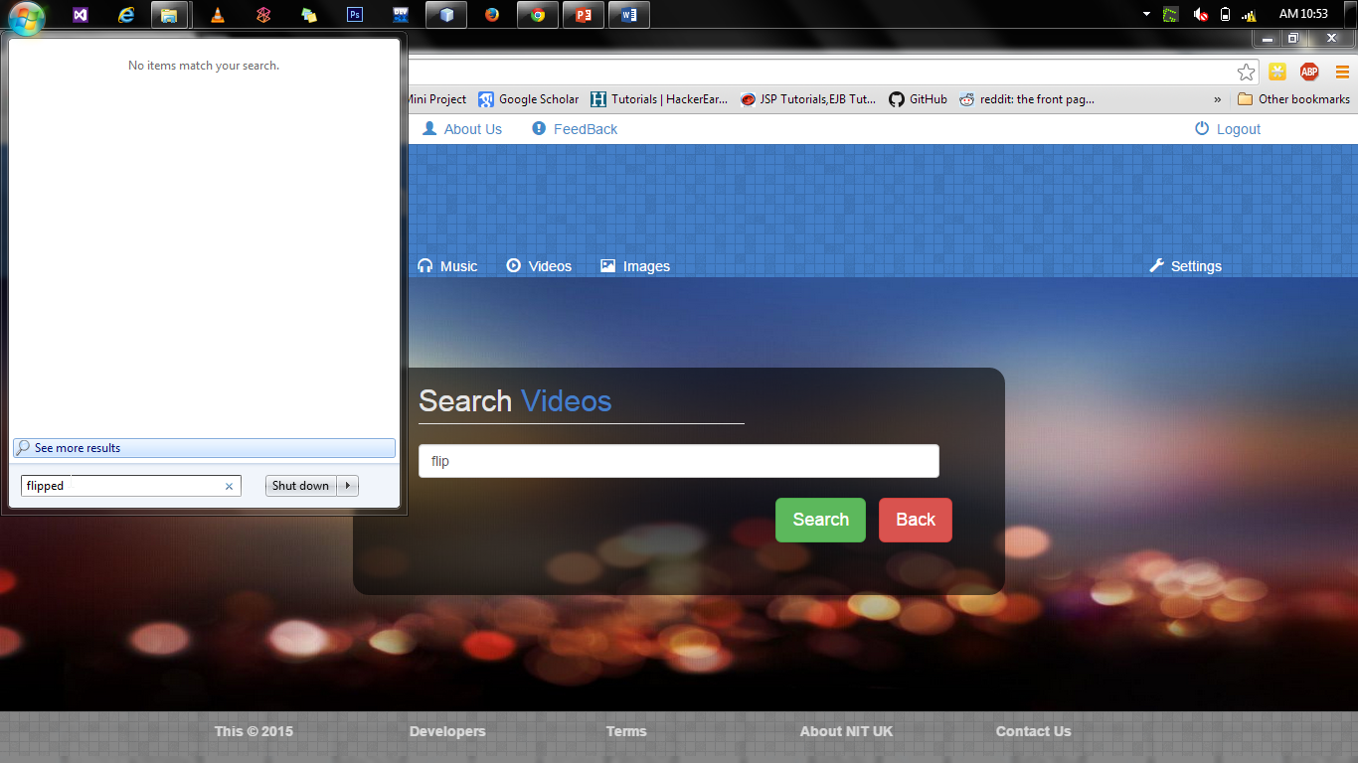
Contd.
Comparison with OS -1
Searching same file in default OS and MyMediaJam

Slide 34
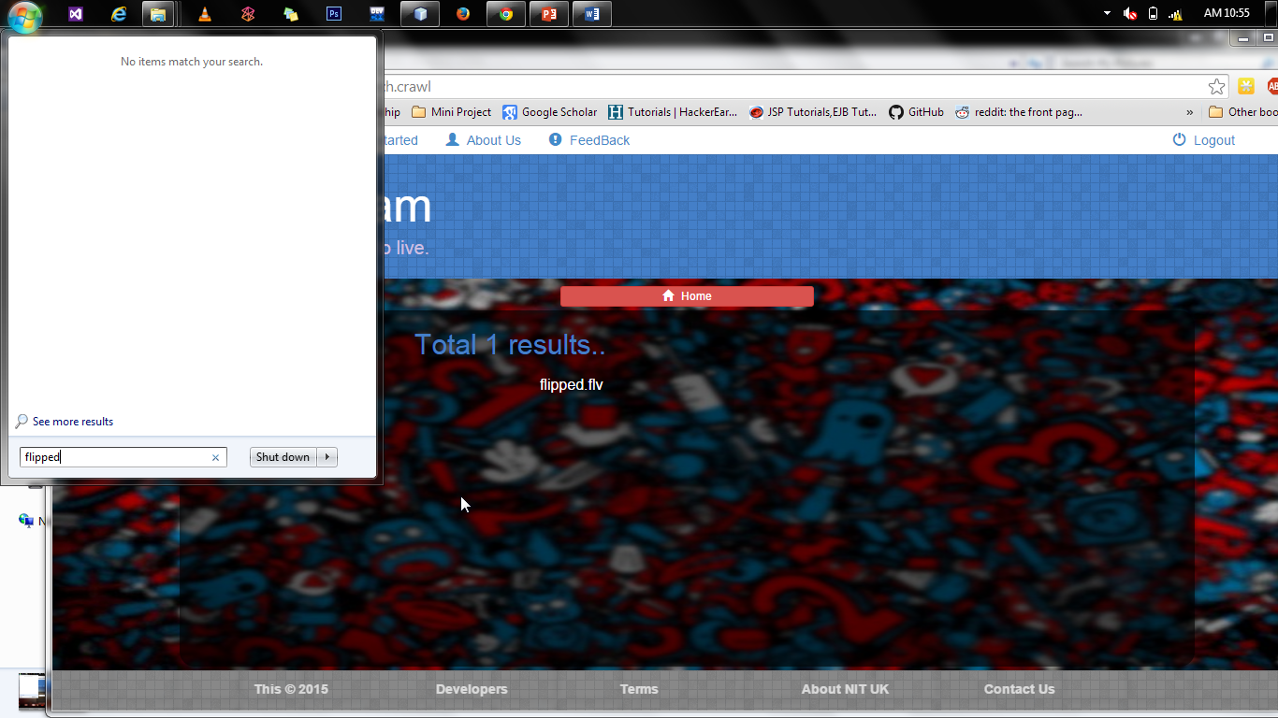
Contd.
Comparison with OS -2
MyMediaJam providing reliable result while OS can’t

Slide 35
REFRENCES
Herbert Shildt, “JAVA: The Complete Reference”, 4th Edition.
Elizabeth Robson and Eric Freeman,”Head First HYPER TEXT MARKUP LANGUAGE and CSS” , 4th Edition.
Kathy Sierra and Berry Bates, “Head First Java”,5th Edition.
Websites :
http://www.stackoverflow.com
http://www.sanfoundry.com/c-program-construct-binary-search-tree/
http://homepages.ius.edu/rwisman/C455/html/notes/Chapter22/DepthFirstSearch.htm
http://www.sanfoundry.com/java-program-implement-red-black-tree/
http://en.literateprograms.org/Red-black_tree_(Java)
http://www.geeksforgeeks.org/red-black-tree-set-1-introduction-2/
http://www.getbootstrap.com
http://codelatte.wordpress.com/2013/11/09/a-simple-newfixedthreadpool-example/
http://startbootstrap.com/template-overviews/full-slider/
http://www.tutorialspoint.com/java/java_multithreading.htm

Slide 36
THANK YOU

